Slide 1
Creating an Augmented Reality Environment to Teach Kids Coding Concepts
Megan Dass

Slide 2
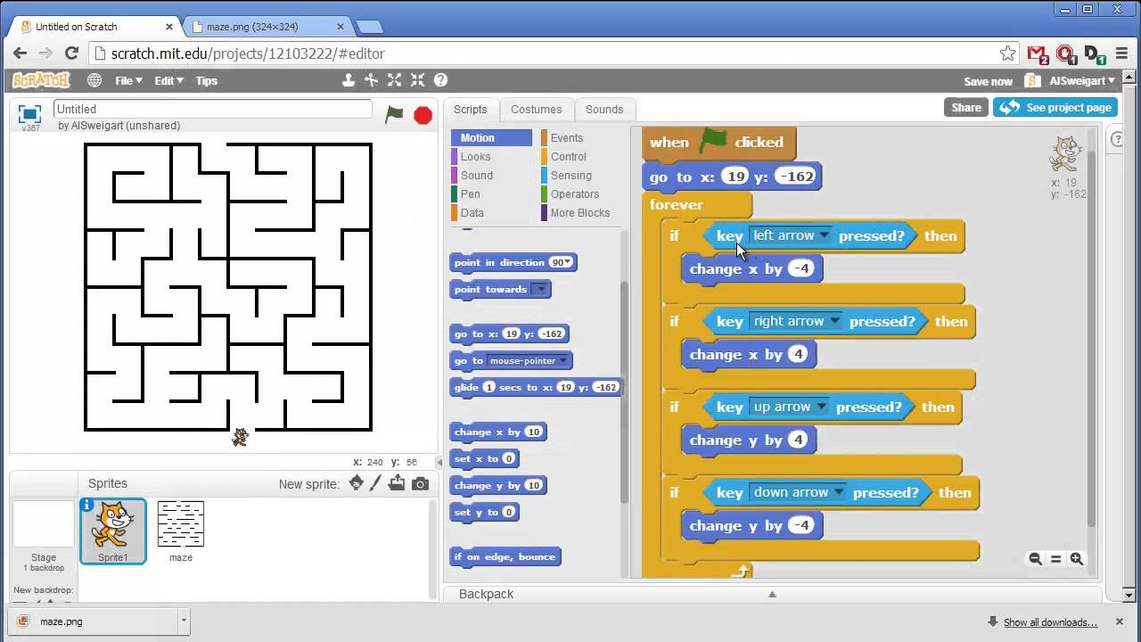
Motivation
Confusing and non-intuitive
Detracting kids from joining CS
Competitive field
Strong foundation necessary

Slide 3
Proposal
My proposal is to create an Augmented Reality Microsoft HoloLens application that teaches children how to start using their problem solving skills and think like a programmer, while immersing them in a fun environment so children become more interested in the CS field.

